Slide 1
Introduction to AI CT017-3-1 Ver 1.0
Expert Systems

Slide 2
Topic & Structure of The Lesson
Characteristics of ES
Development, use of ES
ES life cycle
Constructing ES

Slide 3
Learning Outcomes
At the end of this topic, You should be able to
Expert Systems
Characteristics of Expert System
Development , use and evaluation of Expert System
Expert system Life Cycle
Constructing Expert system

Slide 4
Key Terms You Must Be Able To Use
If you have mastered this topic, you should be able to use the following terms correctly in your assignments and exams:
Expert System Life Cycle
Knowledge Acquisition
Knowledge Representation
Implementation

Slide 5
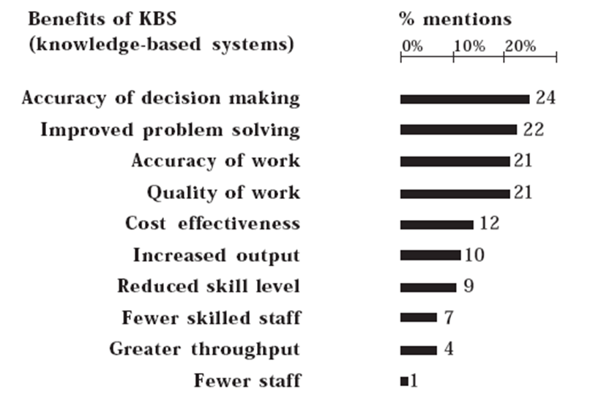
Development, use and evaluation of Expert System
The table below shows the results of a survey indicating
the perceived benefits of expert systems by companies
who were actually using them

Slide 6
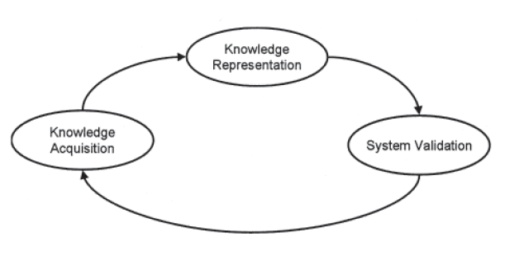
Expert System Life Cycle

Slide 7
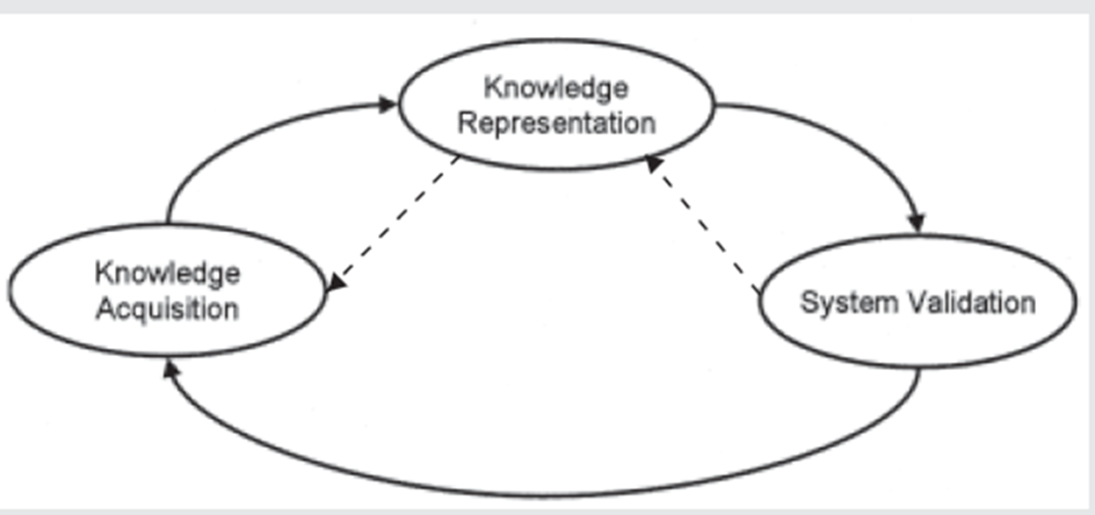
Expert System Life Cycle (cont)
Semantic net
Frame
Production rule
Predicate Logic
Domain Expert
Interview
Documentation
Observation
Programmer
Knowledge Engineer

Slide 8
Constructing Expert Systems
Four main personnel involved in the development of expert systems:
the domain expert
the knowledge engineer
the programmer
Who are people using the expert system
- user

Slide 9
Creating an Expert System
statement of the purpose of the expert system
identification of the domain of the expert system
gathering of domain knowledge
representing domain knowledge
implementing the system
testing the system

Slide 10
Philosophical, practical, legal and ethical issues
Are expert systems really AI?
ability to learn - NO
Creativity - No
reasoning - Yes
use of language - yes
vision - no
problem solving - yes
adapting to new situations - no

Slide 11
Benefits of Expert Systems
Expert systems capture the knowledge of company experts who someday will retire, resign or die.
Expert systems place expert knowledge into machine readable form, where it can be summoned at any time.
Expert systems train newly hired employees to solve problems the way experienced professionals do.
Expert systems are not vulnerable to problems such as fatigue, emotion, and overwork, all of which plague human experts they will also give consistent results

Slide 12
Limitations of expert systems
Can make mistakes and not learn from them.
It is not possible to perfectly mimic the knowledge of an expert
Over-reliance may stifle creativity and initiative

Slide 13
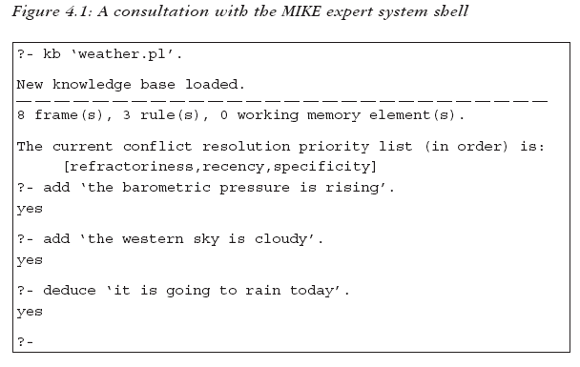
The user interface
Slide 13 of 21

Slide 14
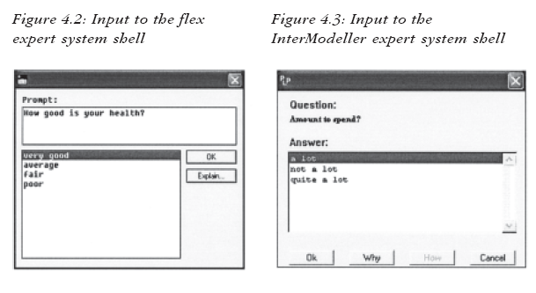
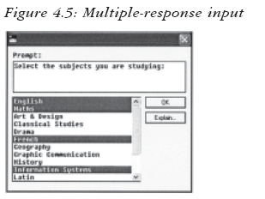
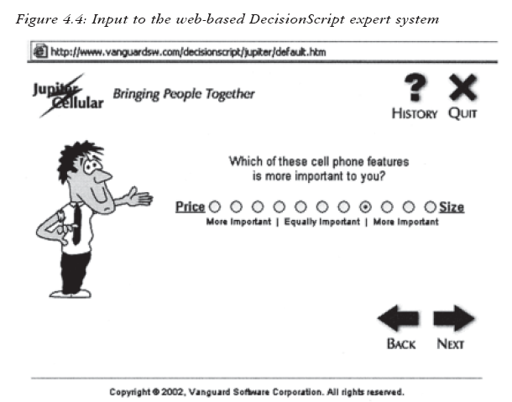
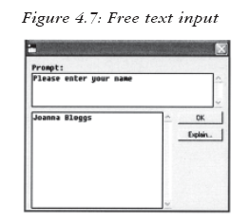
Slide 14 of 21

Slide 15
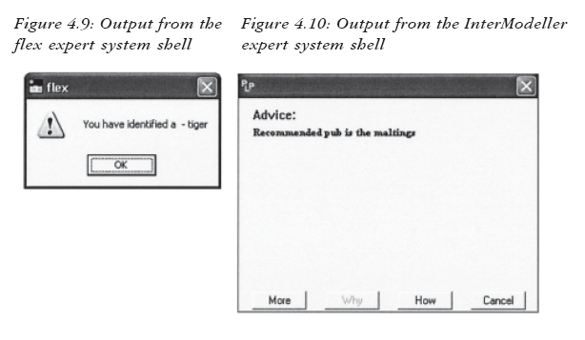
Output from Expert Systems
Slide 15 of 21

Slide 16
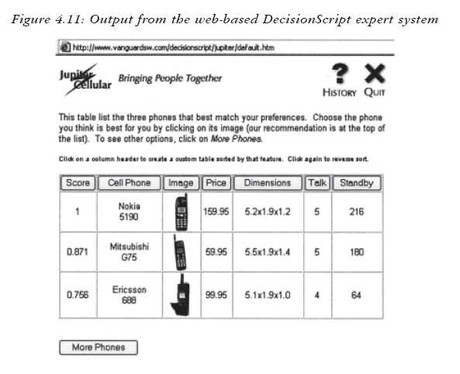
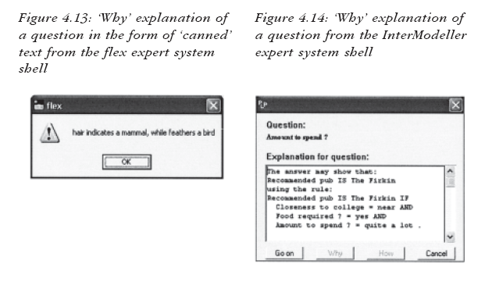
Slide 16 of 21

Slide 17
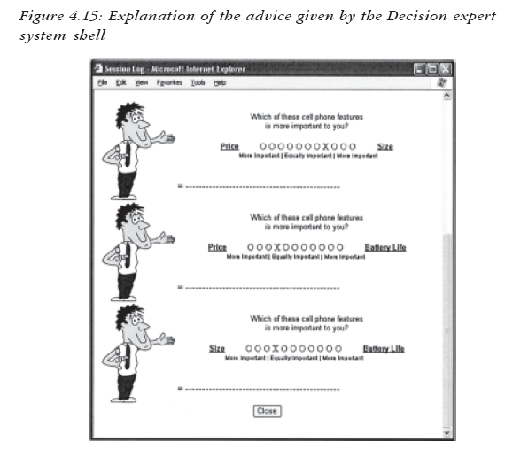
Slide 17 of 21

Slide 18
Quick Review Question
Discuss in class what are the characteristics of an Expert System

Slide 19
Summary of Main Teaching Points
Instead of attempting to create an intelligent program, research focused on creating a means of representing and accessing knowledge.
The result was expert systems, computer programs which could offer advice in a restricted subject where it was possible to create facts and rules representing knowledge.
An expert system is an attempt to replace the human expert and to make their knowledge available in a cost-effective and non-perishable form.

Slide 20
Question and Answer Session
Q & A

Slide 21
What we will cover next
Knowledge Representation 1

